Slide 1
PROGRAMS MANAGER IN C PROGRAMMING LANGUAGE
BY BITTU SINGH
Roll no. CSE-19/030

Slide 2
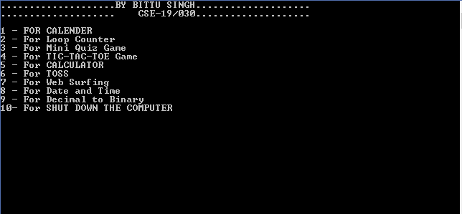
AIM: To select which program to execute using their respective commands.

Slide 3
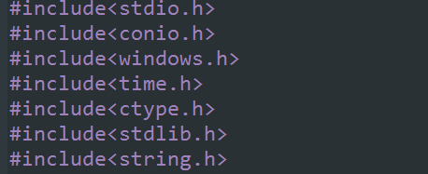
HEADER FILES USED:

Slide 4

CHOOSING THE PROGRAM OPTIONS :
The options are shown and entered using printf() and scanf() command respectively.
The options to choose the program for which to execute is controlled by using if-else statements.

Slide 5



1. Calender
Choosing the options using switch cases.
Clearing the screen using system(“cls”);.

Slide 6

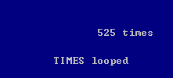
2. LOOP COUNTER
Counts how many times the loop executes when an if statement is infinitely true.
The loop is constantly counting…..

Slide 7
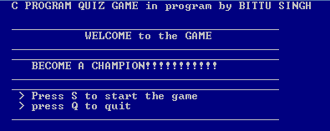
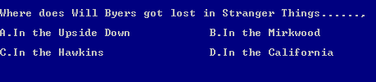
3. MINI QUIZ GAME
A mini quiz game to play for fun.
Options are chosed using if-else and switch statements and executing some parts using function calls.

Slide 8
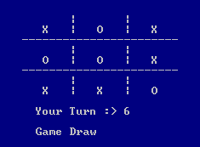
4. TIC-TAC-TOE GAME
A tic-tac-toe game to play for fun against the computer.
SWITCH cases are used…..
Game is working on a complete given data and statistics to win by the computer.

Slide 9


5. CALCULATOR
A simple mathematical calculator.
Using switch cases and function calls.

Slide 10


6. TOSS
A simple toss program like the toss of a coin to get heads or tails completely random.
srand() is used and limit is set to 2 for only heads or tails.

Slide 11

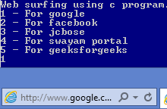
7. WEB SURFING
Opens the default web browser and the respective web page address.
Using System calls functions…..

Slide 12


8. DATE AND TIME
Gives the local date and time of the computer.
Time function is used defined in header file time.h .

Slide 13
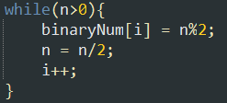
9. DECIMAL TO BINARY CONVERTER
Converts any decimal system number to its binary form.
While and if statements are used.

Slide 14

10. SHUT-DOWN THE COMPUTER
Caution:- It will Shut Down the computer.
system() calls is used to shut down where it is defined in windows core features.

Slide 15
Sources:
GeeksforGeeks
Stackoverflow
Youtube
codewithc.com

Slide 16
THANK YOU

